Slide 1
A service framework
A report to the DLF Steering Committee
Service Framework Group:
Peter Brantley
Lorcan Dempsey
Dale Flecker
Brian Lavoie
Krisellen Maloney
Andy Powell
Mackenzie Smith.

Slide 2
Think about …
Repositories
Metasearch/resolver
Resolver/E-resource management
Aquifer
The library systems environment is changing.
What are the core pieces and how
do they relate?

Slide 3
Think about …
Course management systems
e-portfolio
Chandler
Virtual Research Environment
Search engines
Services need to be delivered at the point of
need – in the workflow

Slide 4
We believe that ..
We have moved past our shared sense of the library and its systems
We do not have a shared model to organize endeavor.

Slide 5
A service framework
… is a tool for organizing attention
… supports discussion, investment, design, development.
… is not a substitute for creativity, bottom up activity, ….

Slide 6
Examples
JISC Information environment
OAIS Reference Model

Slide 7
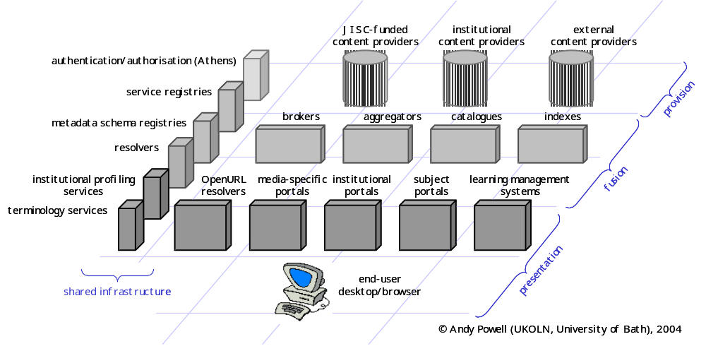
JISC Information Environment

Slide 8
Business requirements
Business processes
Business functions
Abstract services
Service bindings
Deployed services
Business entities
e.g. Rights, licenses,
collections, services, organizations,…
Elements of the proposed framework

Slide 9
Digital Collection Management
Collection Building
Collection Maintenance
Collection Destruction
Set Policy
Inventory
Set Policy
Inventory
Inventory
Target Discovery
Selection
Access control
Reporting
Access control
Access control
Target Selection
Source Discovery
Describe
Selection
Describe
Describe
Target Transaction
Source Selection
Contextualize
Source Discovery
Contextualize
Contextualize
Send
Source Transaction
Register
Source Selection
Register
Register
Destroy
Receive
Source Transaction
Target Discovery
Receive
Target Selection
Preserve
Target Transaction
Business Requirement
Send
Business Process
An example of early modeling
Abstract Service

Slide 10
Benefits
Contributes towards:
  A more modular approach to design and development
  A foundation for collaboration among libraries
  Lower development and ownership costs.
  Expressing the value of the library to other communities
  Alignment of library planning
  Identification of gaps and development needs

Slide 11
Why this matters
Very difficult to effectively
  Federate digital library services
  Realize savings through shared systems and services or components from third parties
  Respond to change with flexible modular systems environments
  Align strategic objectives and systems environments.

Slide 12
In fact …
Aquifer cannot be understood, planned or implemented in the absence of a service framework
Standards investment can't be responsibly made without a service framework
We can't interact with the crucial external communities and workflow builders without a service framework

Slide 13
Recommendations
Recommendation 1
  Secure dedicated effort to advance framework.
  A fellow.
  Seek shared funding but be prepared to entirely fund.
  Charge to Director to work with SF Group to bring proposal to Executive Group.
Recommendation 2
  Research library of the future
  Scenario work
  Seek to advance work with CNI, Mellon, ….

